Slide 1


Update: 05/12/08
Notes:
richard.g.morris@tesco.net

Slide 2

Most electronics complete & working
Most flight computer programming complete
All equipment ordered (except balloon, parachute, Ext. Sound card, camera)

Slide 3

Buy stuff
Case design
Antennas
Camera and control
Software ground-side
Lots of testing!

Slide 4

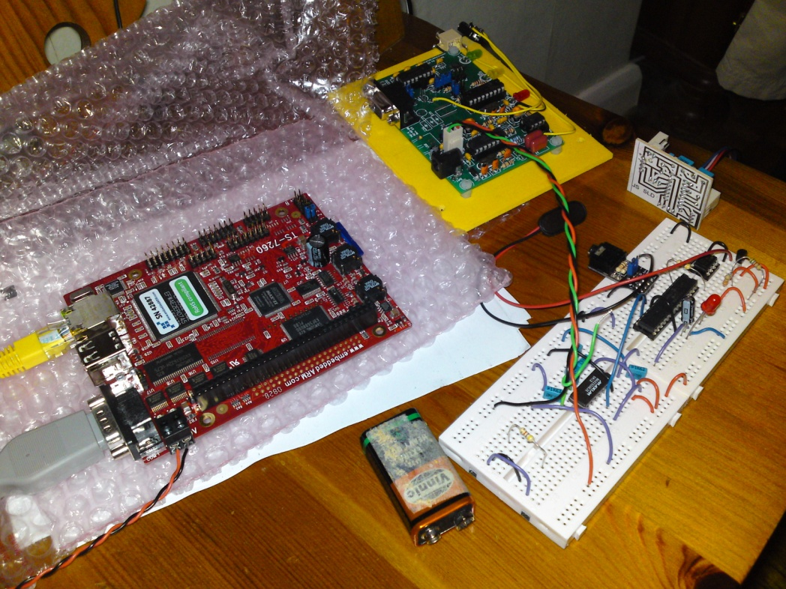
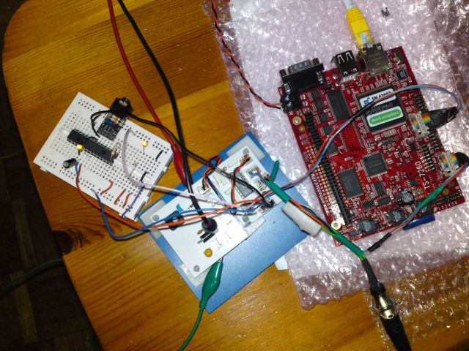

Slide 5
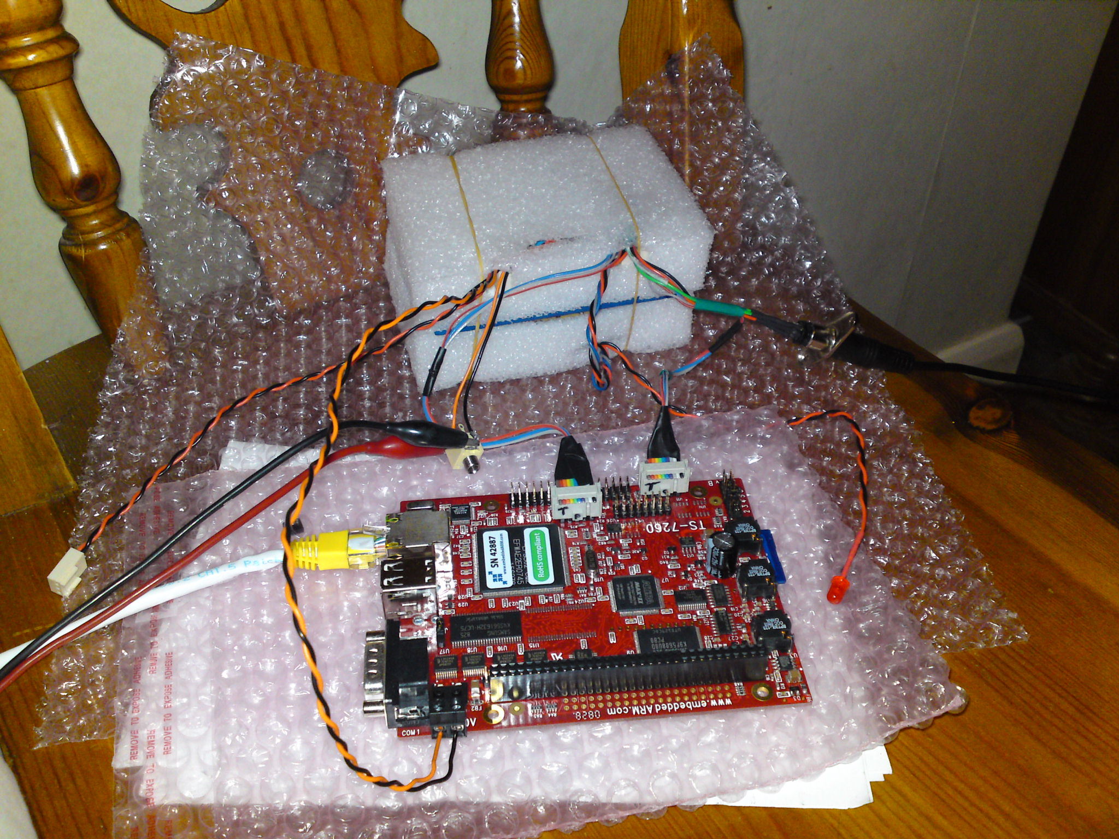

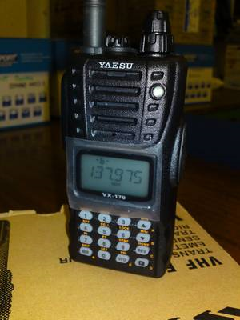

Slide 6

Google Earth (1)
  TCP socket comms
  Protocol / KML (APRSKML)
433mhz tx set
  Tx signal (2)
  Design/produce/test PCB (2)
  Design/build/test Yagi antenna (3)
Virgin/Sponsorship (4)
Launch site finding (5)
Weather forecasting for the launch day (5)

Slide 7

You need to know about:
  Egg beater
  Yagi
  J-pole/Slim Jim
  Turnstile
Principles/ideas behind these designs.
Why you would choose one design over another for a given problem?

Slide 8

APRS (Automated Packet Reporting System)
AX.25
TNC (Terminal Node Controller)
AGWPE (Software TNC emulation)
NMEA 0183
GPS (DGPS, AGPS, EGNOS, WAAS, SA, LORAN)

Slide 9

http://balloon.hexoc.com – Project Log
http://balloon.hexoc.com/gallery - Pictures

